Slide 1
Gesture Optimised Keyboard Layouts
MTech Interim Project Report · Nov 2016
Mohan Pednekar
Mohan Pednekar
CS15M064
IIT Madras
Project Guide
Prof Rupesh Nasre
IIT Madras

Slide 2
Motivation
Physical keyboards designed for two hands
Gesture Typing popular on smartphones
Ambiguous word gestures
Possible gesture speed improvements
Experiments with different layouts

Slide 3
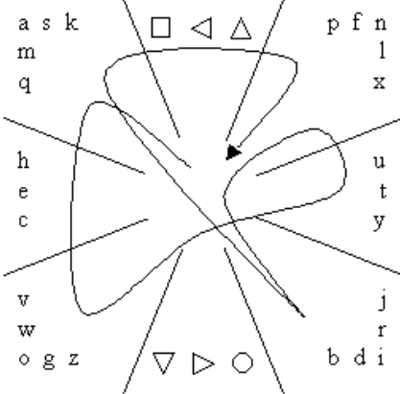
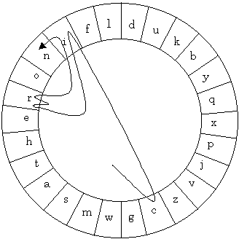
Background Study
Dead Zone based keyboards
  Accurate
  Time consuming
  Cirrin Quikwriting

Slide 4
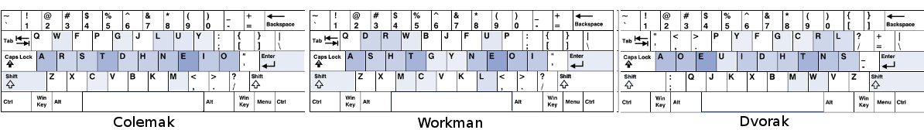
Traditional Row Layouts
Qwerty designed for Typewriters
Dvorak, Colemak, Workman for two hands
None of them designed for gesture typing
Linear rows introduce duplicate gestures

Slide 5
Existing Study
Brian Smith, Xiaojun Bi, Shumin Zhai proposed 4 new layouts with different objectives
  GK-C : Clarity / Accuracy
  GK-S : Speed
  GK-D : Clarity and Speed
  GK-T : Clarity, Speed and Qwerty similarity
Technique Used : Pareto Optimisation on Single, Double and Triple Metrics

Slide 6
Metrics
Gesture Clarity
  Average of distance from nearest neighbour
Gesture Speed
  Inverse of time taken to draw gesture
Qwerty Similarity
  Change of positions from Qwerty

Slide 7
Pareto Optimisation
Metric Normalisation
  Minimum and Maximum raw score for each metric
  10-30 Optimisations
  2000 iterations per optimisation
  Swap two random keys after each iteration
  Simulated Annealing to keep layouts
    Keep better layouts with 100% probability
    Keep other layouts with a fixed probability
  Normalised scores used for next step

Slide 8
Pareto Optimisation
Pareto Front Initialisation
  22 different weightings
  15 local neighbourhood searches
  2000 iterations per search
  Maximise linear combination score
  Start with empty, add pareto optimal layouts
Pareto Front Expansion
  200 passes over pareto front

Slide 9
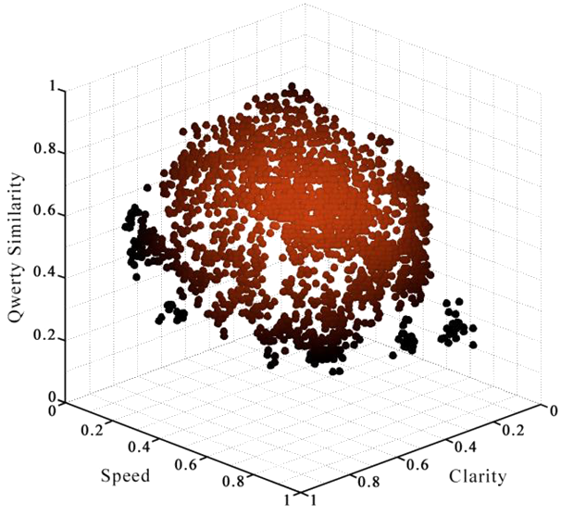
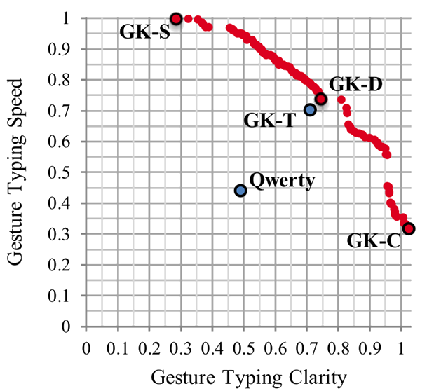
Pareto Front

Slide 10
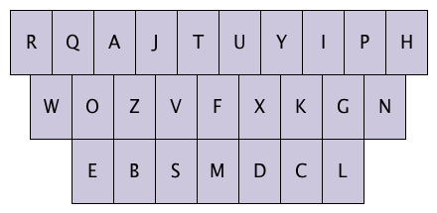
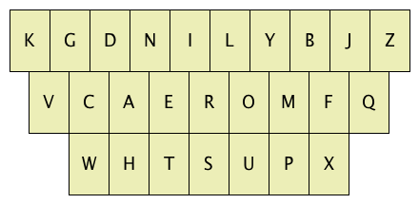
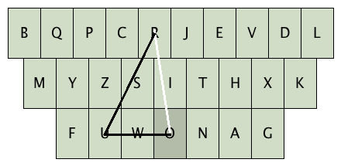
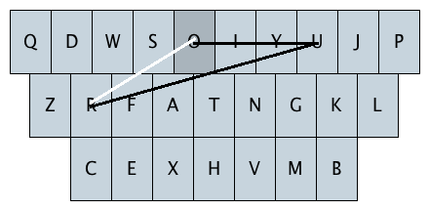
Results
GK-C GK-S
GK-D GK-T

Slide 11
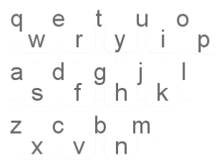
Proposed Modifications
Different number of rows
Interlacing (iQwerty)
Non linear arrangement
Pareto optimal trials

Slide 12
Metric Changes
Gesture Clarity
  B-splines instead of straight lines
Gesture Speed
  Usage of bigrams, trigrams and quadgrams
Qwerty Similarity
  Euclidean distance instead of Manhattan distance

Slide 13
Current Status
Corpus Processing
  Brown Corpus (about 50000 unique words)
  Top 5000 words used
  Ngrams and their frequencies
  Probabilities of each (n+1)gram for given ngram
Interface Quantisation
  Standard keyboard layout used
  Centre of each key taken as position
  Ideal trace calculations

Slide 14
Future Work
Ideal trace midpoints will be used for B-splines
Testing on Qwerty and iQwerty
Usage of Modern Corpora
New layout proposals based on results
Design change proposals
Real world experiments

Slide 15
Thank You!

